Slide 1
Polar Codes:
A New Way Of Achieving Shannon Capacity
Prepared by Lab Group 6 - Group 1

Slide 2
Honor Code
We declare that
→ The work that we are presenting is our own work.
→ We have not copied the work (the code, the results, etc.) that someone else has done.
→ Concepts, understanding and insights we will be describing are our own.
→ We make this pledge truthfully. We know that violation of this solemn pledge can carry grave consequences.

Slide 3
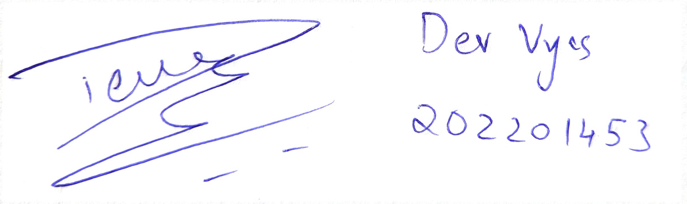
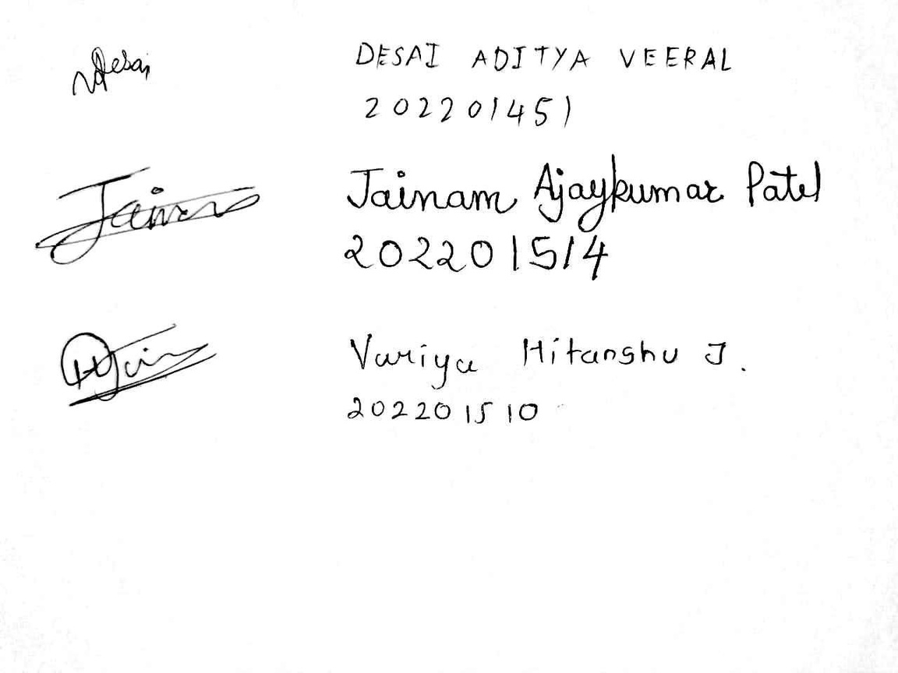
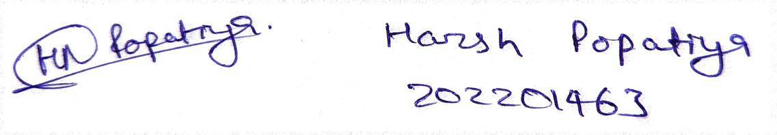
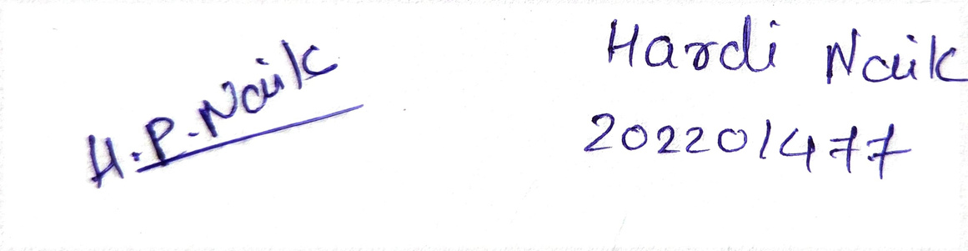
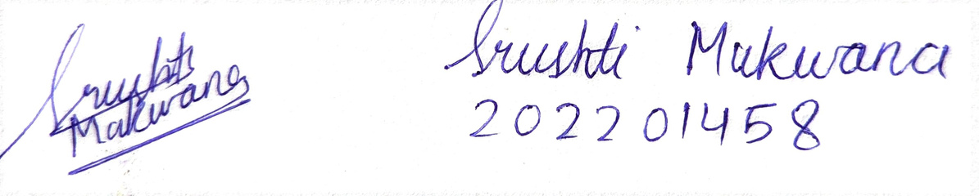
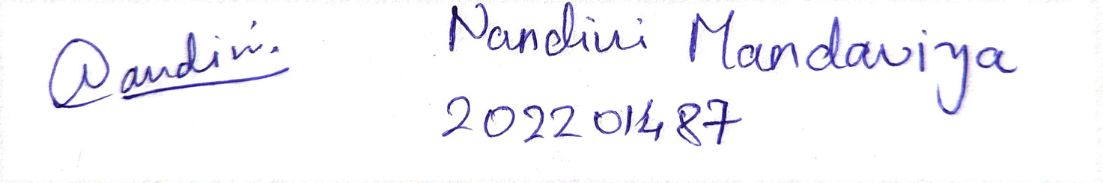
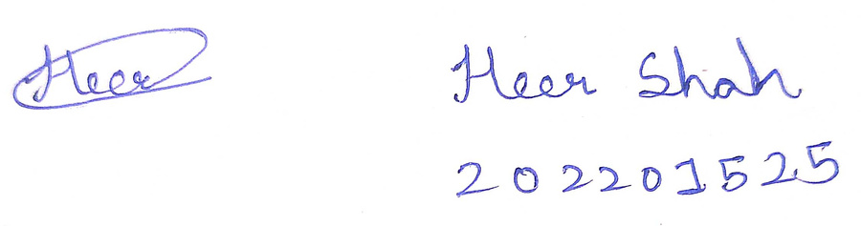
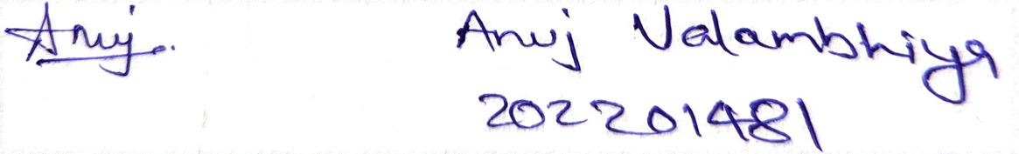

Attested by:

Slide 4
Group Members
Aditya Desai (202201451)
Dev Vyas (202201453)
Srushti Makwana (202201458)
Harsh Popatiya (202201463)
Hardi Naik (202201477)
Anuj Valambhiya (202201481)
Nandini Mandaviya (202201487)
Hitanshu Variya (202201510)
Jainam Patel (202201514)
Heer Shah (202201525)
Dhruvin Chaudhary (202101239)

Slide 5
Page
Table of
Contents
I
Introduction
6
II
An analogy to understand Polar Codes
7
III
Why Polar Codes?
8
IV
Polar Transformation
9
V
Theory of Polarization
12
VI
How Polar Codes work?
13
VII
Encoding Algorithm
27
VIII
AWGN and BPSK
33
IX
Decoding Algorithm
35
X
Decoder Comparison Output
65
XI
Appendix
75
XII
References
84

Slide 6

Introduction
Polar Codes were discovered by Erdal Arikan in 2008. They have become the most favourable codes for Forward Error Correction since then. They are notable for being first in their types with provable capacity-achieving property. Polar codes have especially found their application in the 5G wireless communication.
“Polar Codes were not invented, they were discovered.”
~Erdal Arikan
6

Slide 7
An Analogy to
Understand Polar Codes

Slide 8
Why Polar Codes?
Polar codes propose a new approach to achieve the Shannon capacity. Instead of encoding data bits like traditional methods, polar codes polarize the channel into two extreme channels: highly reliable and less reliable. They then utilize the highly reliable channels to transfer the data bits, unlike different pre-existing coding techniques that focus on encoding the data bits. Thus, Polar Codes provide ease by working directly over channels rather than the data bits.
8

Slide 9
Polar
Transformation

Slide 10
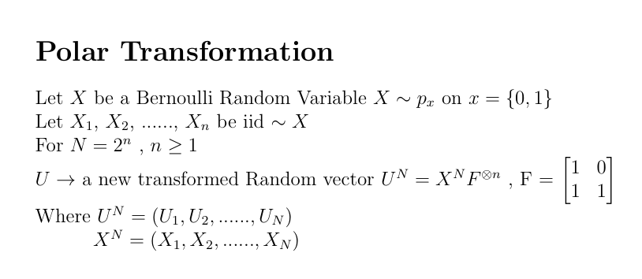
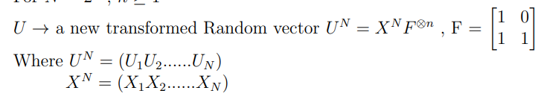
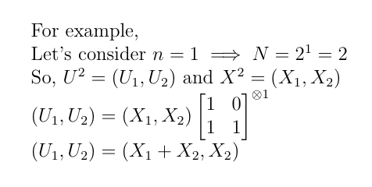
10

Slide 11
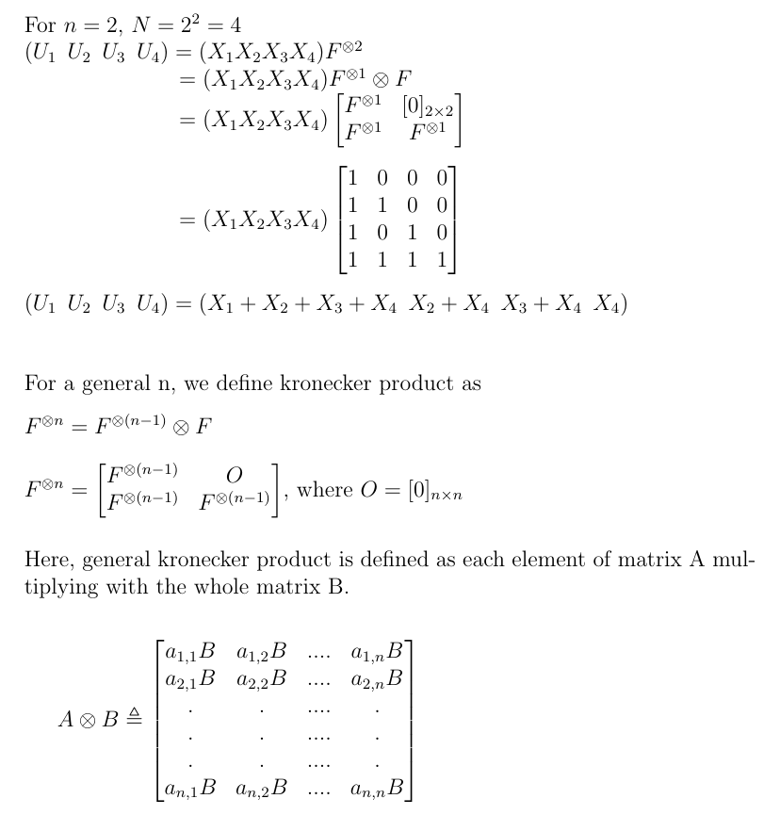
11

Slide 12
Theorem of Polarization

Slide 13
How Polar Codes work?

Slide 14
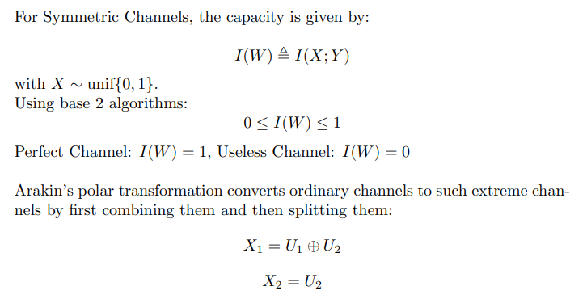
Erikan’s
14

Slide 15
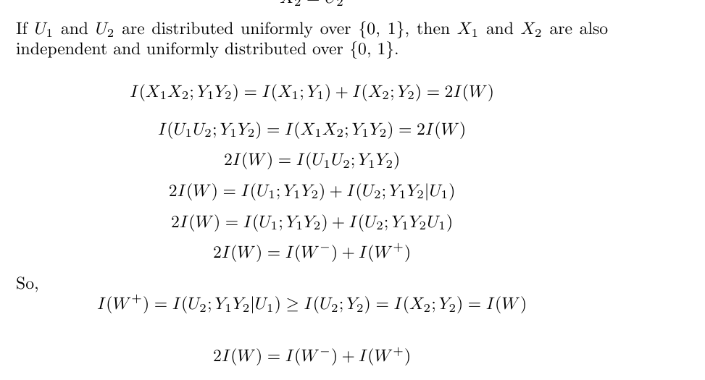
(Using the chain rule)
15
Notes:
U1 and U2 are IIDs

Slide 16
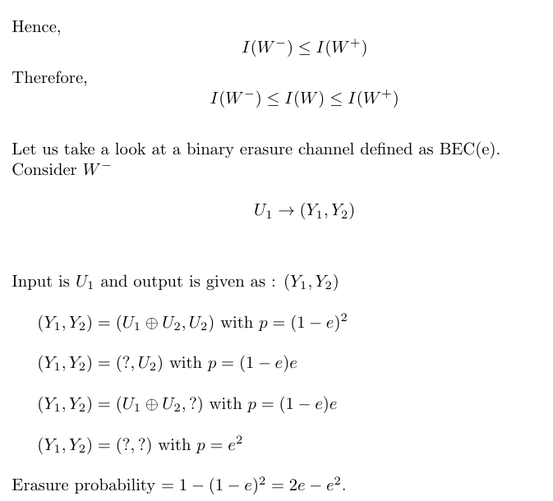
16

Slide 17
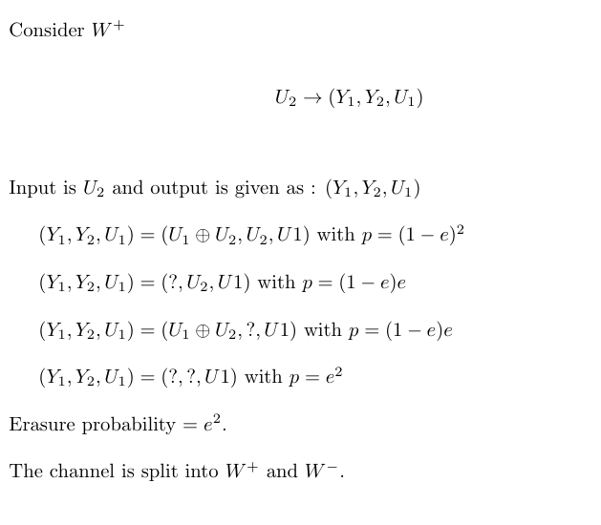
17

Slide 18
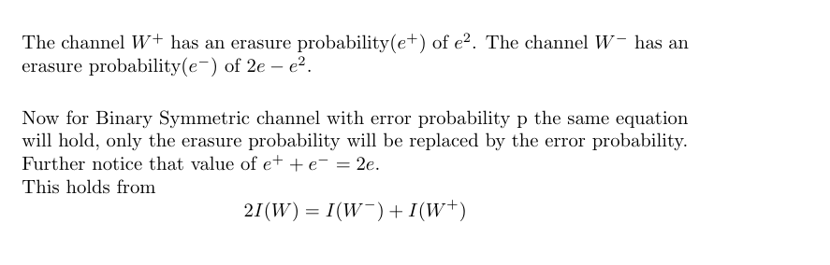
18

Slide 19
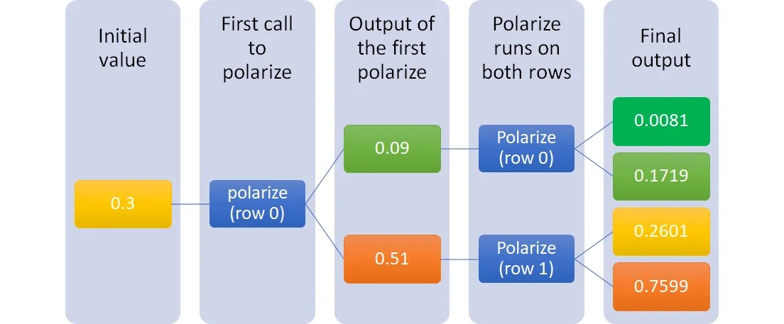

Slide 20
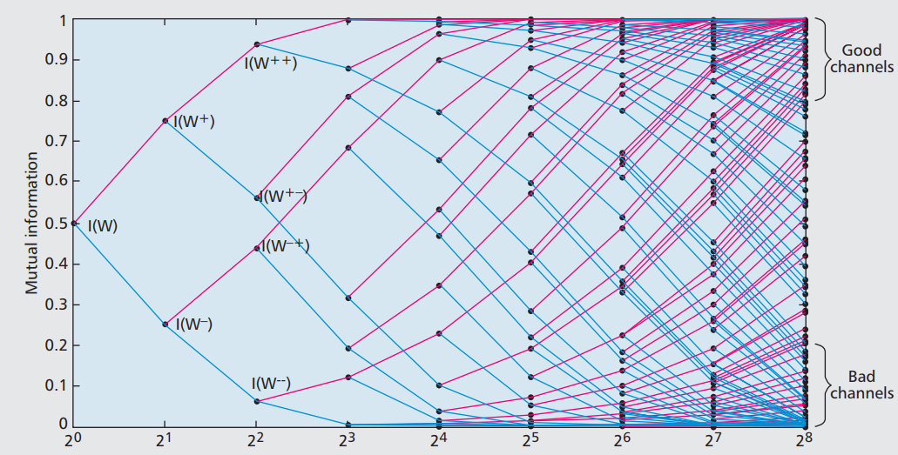
Polarization Martingale
20

Slide 21
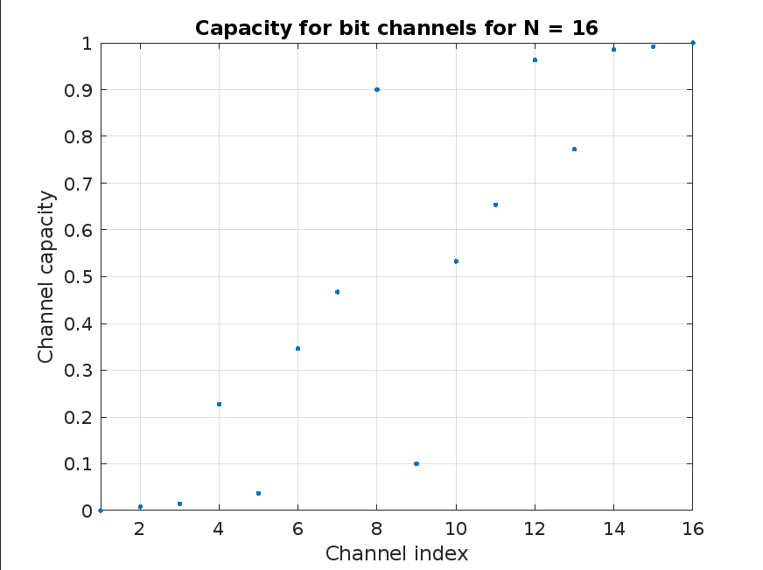
Polarization of BEC(1/2) for N=16
Methodology
21

Slide 22
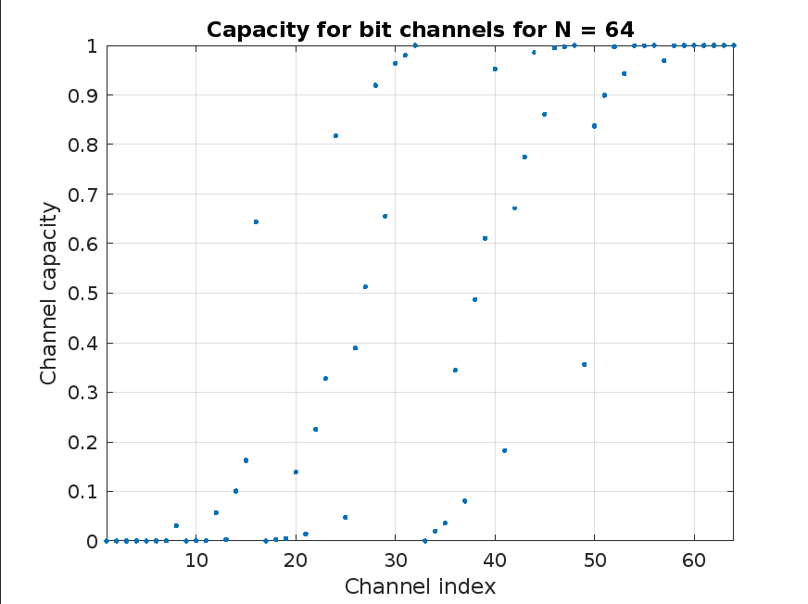
Polarization of BEC Rate (1/2) N=64
22

Slide 23
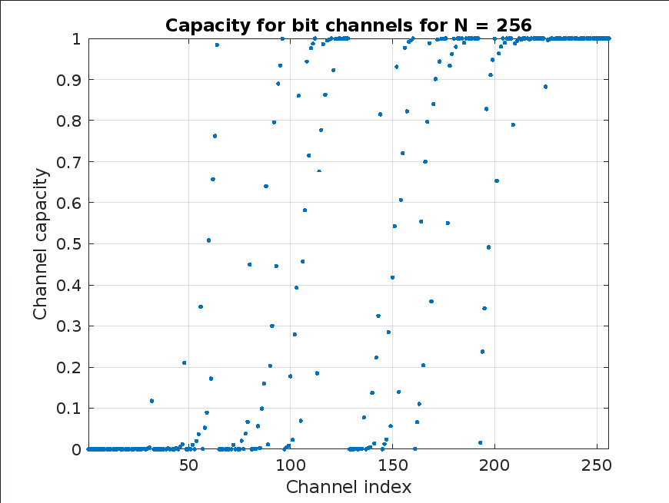
Polarization of BEC Rate (1/2) N=256
Research Results
Bar Chart
23

Slide 24
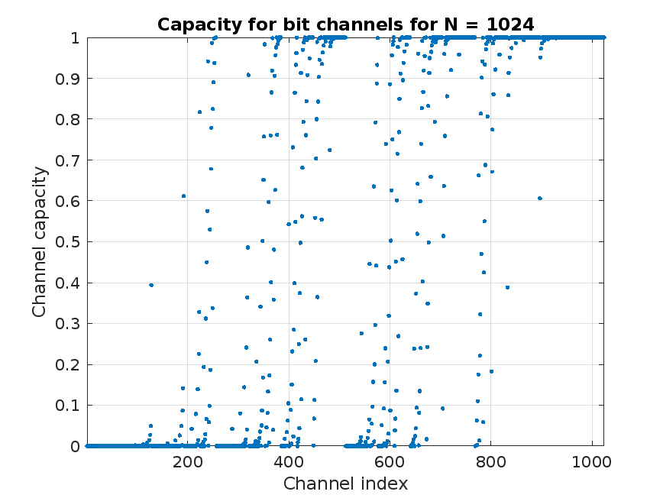
Polarization of BEC(1/2) for N=1024
24

Slide 25
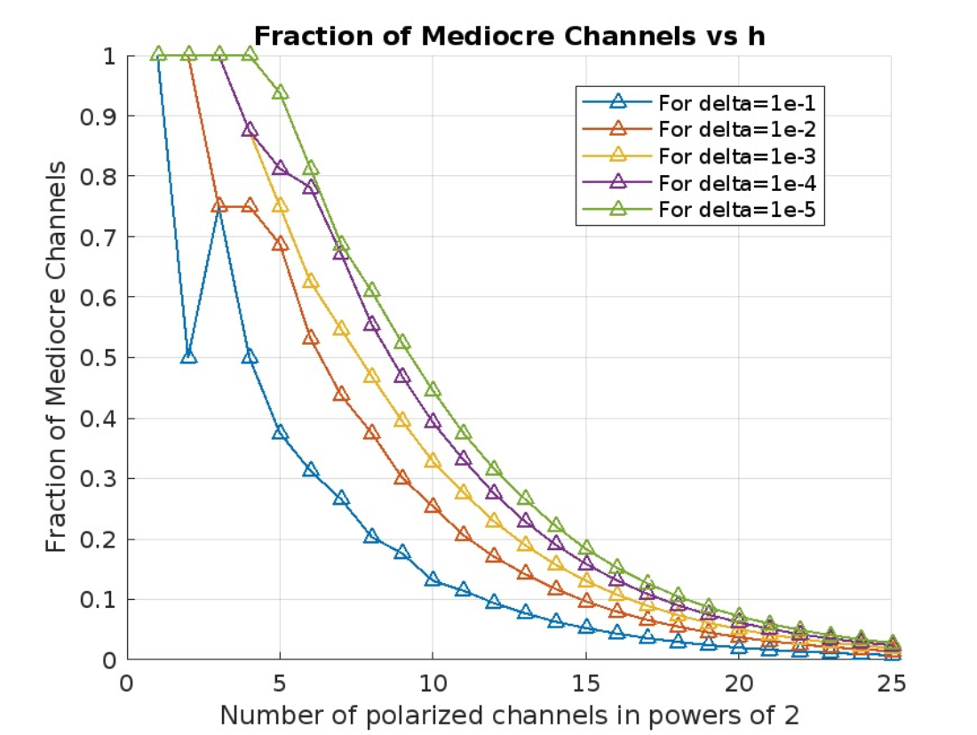
25

Slide 26
Observations :
In polar codes, as the value of N (representing the number of channels) increases, the number of channels approaching capacity extremes (0 or 1) also increases.
We observe a greater quantity of extreme channels compared to mediocre ones.
Polar codes strategically allocate frozen bits to channels with poor performance (the "worst" channels) and reserve efficient channels for transmitting message bits.
This allocation minimizes error probability by leveraging channel characteristics.
As N tends towards infinity, the error probability diminishes significantly, converging towards Shannon capacity.
This demonstrates the remarkable efficiency and effectiveness of polar codes in maximizing transmission reliability.
26

Slide 27
Encoding Algorithm

Slide 28
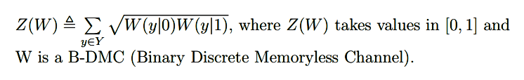
Reliability Sequence:
It is a sequence which gives a sorted order of channels starting from worst channels to the best channels according to the efficiency of the output.
For N=16 the reliability sequence is:
1 2 3 5 9 4 6 10 7 11 13 8 12 14 15 16
The reliability sequence is derived using the Bhattacharya Parameter, which is defined as below:
28

Slide 29
Suppose we have a message m having K bits. We need to generate a codeword C having N (N=2 )bits.
n
Algorithm:
Find first N-K worst channels for N based on the reliability sequence.
For all the N-K positioned indexes in the vector u we set the bits to zero. These positions are also known as Frozen Positions.
Set the remaining K bits of vector u as the message bits.
Now, to generate the final codeword or the encoded message we need to multiply vector u with the Generator Matrix G based on the polar transform defined earlier.
Hypothesis 3
n
Codeword C = u.G
n
Example:
Message m: 4 Bits (K=4)
Codeword C: 8 Bits (N=2 )
Reliability Sequence: 1 2 3 5 4 6 7 8
3
29

Slide 30

0
0
1
[m3+m4 m4]
[0 0]
[m1 m1]
[m2 m2]
0
1
2
3
0
1
2
3
4
5
6
7
0
0
0
m1
0
m2
m3
m4

Slide 31
0
[m2+m3+m4 m2+m4 m3+m4 m4]
[m1 m1 m1 m1]
0
1
[m3+m4 m4]
[0 0]
[m1 m1]
[m2 m2]
0
1
2
3
0
1
2
3
4
5
6
7
0
0
0
m1
0
m2
m3
m4

Slide 32
C=[m1+m2+m3+m4 m1+m2+m4 m1+m3+m4 m1+m4 m2+m3+m4 m2+m4 m3+m4 m4]
0
[m1 m1 m1 m1]
[m2+m3+m4 m2+m4 m3+m4 m4]
0
1
[m1 m1]
[m2 m2]
[m3+m4 m4]
[0 0]
0
1
2
3
0
1
2
3
4
5
6
7
0
0
0
m1
0
m2
m3
m4

Slide 33
AWGN and BPSK

Slide 34
G4
BPSK
+
AWGN
u1
x1
r1
u2
x2
r2
u3
x3
r3
u4
x4
r4
For a BPSK Channel the bit conversion scheme is
1 is converted to -1
0 is converted to 1
AWGN is added during transmission
34

Slide 35
Decoding Algorithm

Slide 36
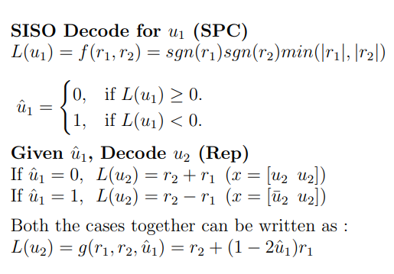
Successive Cancellation Decoding
Basic Building Block N=2 SC Decoder
There are two main functions we require for Successive Cancelation Decoder. They can also be described as two types of SISO decoders used in different parts of the SC decoding algorithm. They are as described below:
36
Proof of SISO SPC decoder and SISO Repetition decoder in Appendix

Slide 37
Successive Cancellation Decoding(N=2)
Step 1
Step 2
Step 3
r = [r1 r2] x=[x1 x2]
r = [r1 r2]
x̂=[û1+û2 û2]
f(r1,r2)
û1
û1
û2
g(r1,r2,û1)
u2
u1
u2
u2
u1
u1
37
We repeat the above three steps till we traverse the whole tree (For N>2)

Slide 38
Successive Cancellation Decoding(for any N)
M = 2
m
Step U
Step R
Step L
[û1+û2 û2]
L = [L1 L2 ..... LM]
M bits
g(L(1:M/2),
L(1+M/2:M),
û1)
û1
û1
û2
f(L(1:M/2),
L(1+M/2:M))
M/2 bits
M/2 values
M/2 bits each
M/2 values
f(a(1:p),b(1:p))=[f(a1,b1)f(a2,b2) ...f(ap,bp)]
g(a(1:p),b(1:p),c)=[g(a1,b1,c1)g(a2,b2,c2) ...g(ap,bp,cp)]
Here f and g functions are the same as defined earlier
38
We repeat the above three steps till we traverse the whole tree (For N>2)

Slide 39
Successive Cancellation Decoding(for any N)
L(ui)
ûi
ui
If ‘i’ is a Frozen Position: ûi=0
If ‘i’ is a message Position:
ûi=0, if L(ui) ≥ 0
ûi=1, if L(ui) < 0
We repeat the above step for all the leaf nodes till we traverse the whole tree (For N>2)
39

Slide 40
Successive Cancellation Decoding
Algorithm:
Start at the root.
For intermediate nodes
Do step L and go to the left child.
2. Once the decision (û1) is recieved from the left child, do step R and go to the right child
3. When decision is received from the right child (û2), do step U and go to the parent.
For Leaf nodes
Leaf must make a decision and send it to the parent
40

Slide 41
Simulating Outputs

Slide 42
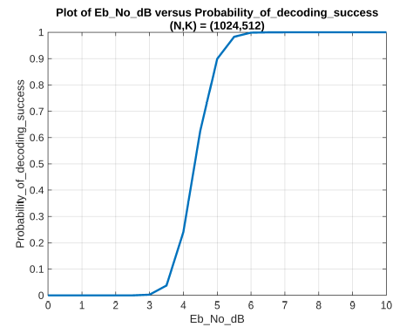
42

Slide 43
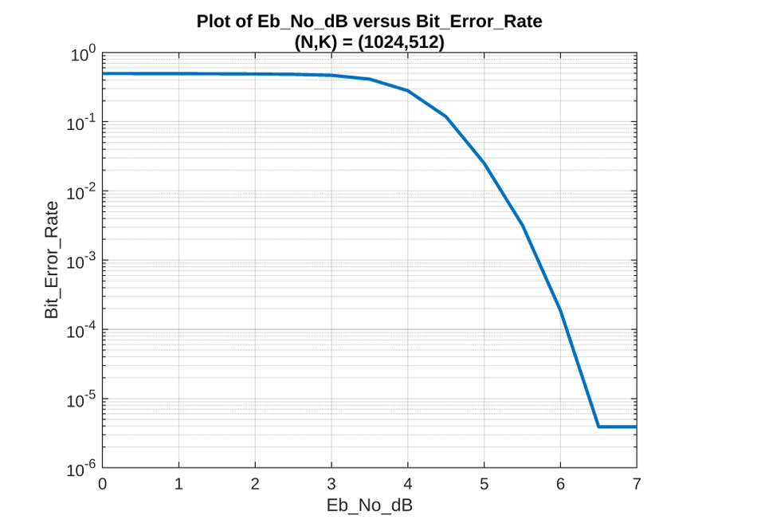
43

Slide 44
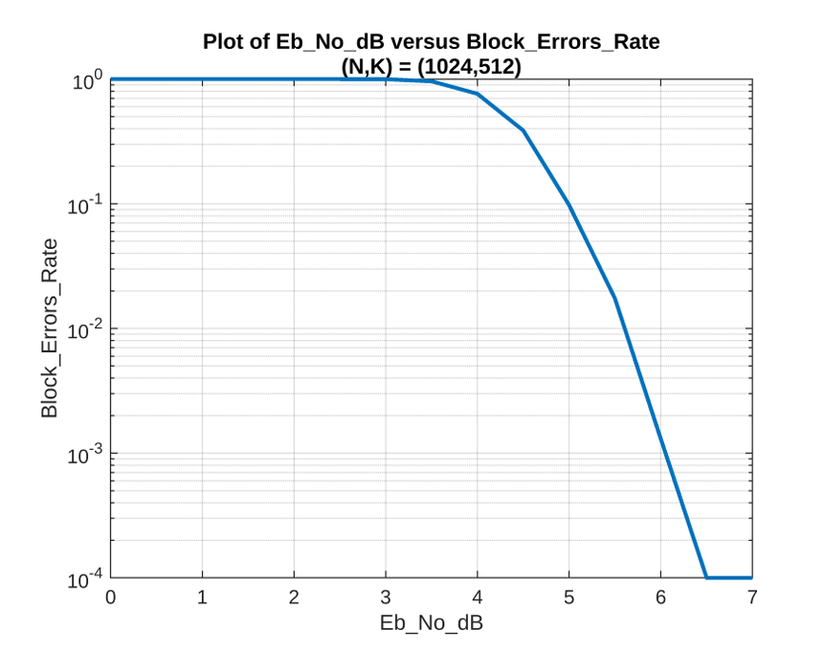
44

Slide 45
Functionality Test

Slide 46
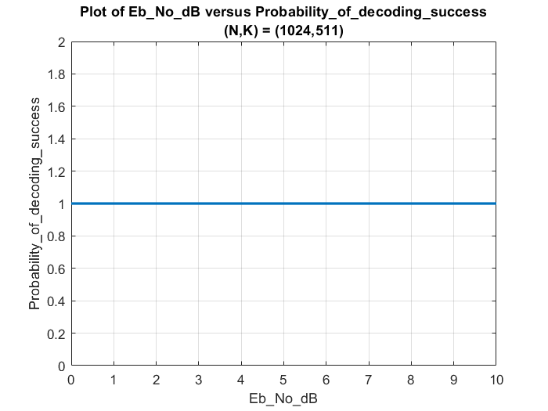
46

Slide 47

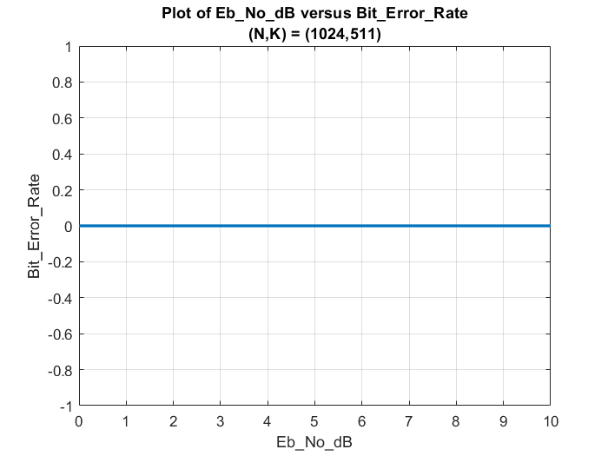
47

Slide 48
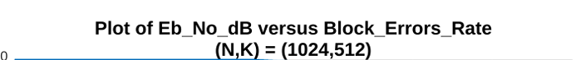
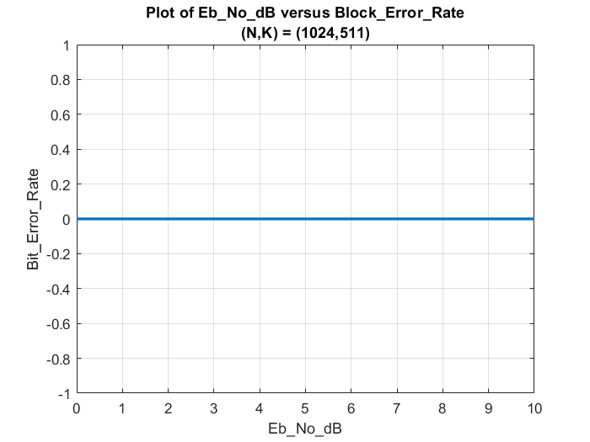
Block_Error_Rate
48

Slide 49
Successive Cancellation Decoding : `Disadvantages
SC requires the decoding process to advance bit by bit. This results in high latency and low throughput when implemented in hardware [cite].
Polar codes decoded with SC only achieve the channel capacity when the code length tends toward infinity. For practical polar codes of moderate length, SC decoding cannot provide a reasonable error-correction performance.
SCL Decoder is about 1dB better than SC decoder.
49

Slide 50
Successive Cancellation List : Decoding Block Diagram
M codeword
Add CRC
EncodeR
BPSK
+
AWGN
LIST DECODER
CHECK CRC
Estimated Message
msg
A
bits
K bits
N bits
(N,K) code
M : list size
50

Slide 51
Cyclic Redundancy Check (CRC)
CRC is a method to detect error in digital networks. It is used to change accidental changes in data.
In this method, we divide the message by a selected polynomial to get a remainder polynomial which we then append it to the end of message to form our new codeword which we then transmit.
On the receiver side, after decoding, we divide decoded codeword by the selected CRC polynomial.
If the remainder on division comes out to be zero then it is a valid codeword.
51

Slide 52
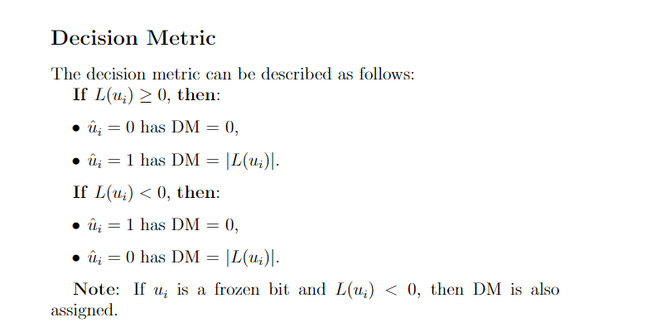
Path metric:
Sum of decision metrics for every path is called Path metric.
52

Slide 53
Algorithm:
Here we use as many SC decoders as our list size (L) and run them together.
We follow the same procedure as SC decoder for all the concurrent decoders except at the leaf.
At the leaf we do following extra procedures as follows:
We consider all possible estimated bits for a given belief
We keep track of path metric in which we assign a penalty (absolute value of belief) for taking an opposite decision for a given belief.
Then we sort and take the first L decoders having minimal path metrics.
After we receive the L decoded codewords we perform a CRC check.
53

Slide 54
Possible scenarios during CRC check on L decoded codewords
When none of the codewords yield zero remainder
When only 1 of the codeword yield zero remainder
When more than 1 codewords yield zero remainder
Choose codeword with minimum path metric
Choose codeword with minimum path metric
Select that codeword
54

Slide 55
SC decoder 1
DM (0) + DM (0)
0
1
12
SC decoder 1
DM (0)
u2
1
0
1
SC decoder 2
DM (0) + DM (1)
1
12
SC decoder 1
PM = 0
u1
SC decoder 3
DM (1) + DM (0)
0
1
1
22
SC decoder 2
DM (1)
u2
1
1
SC decoder 4
DM (1) + DM (1)
1
22

Slide 56
0
1a : PM1 + DM1i(0)
X
SC decoder 1
PM 1
ui
1
1b : PM1 + DM1i(1)
ui+1
0
2a : PM2 + DM2i(0)
ui+1
SC decoder 2
PM 2
ui
1
2b : PM2 + DM2i(1)
X
0
3a : PM3 + DM3i(0)
X
SC decoder 3
PM 3
ui
3b : PM3 + DM3i(1)
X
1
0
4a : PM4 + DM4i(0)
ui+1
SC decoder 4
PM 4
ui
4b : PM4 + DM4i(1)
ui+1
1

Slide 57
Simulating Outputs

Slide 58
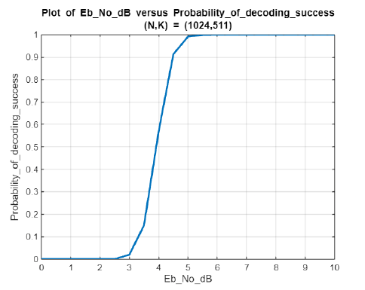
58

Slide 59
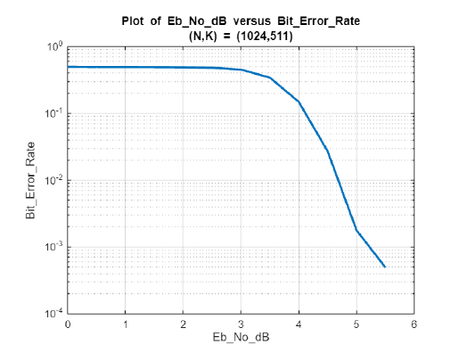
59

Slide 60
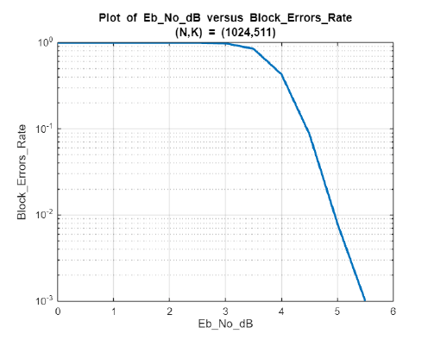
60

Slide 61
Simulating for different (N,K)’s

Slide 62
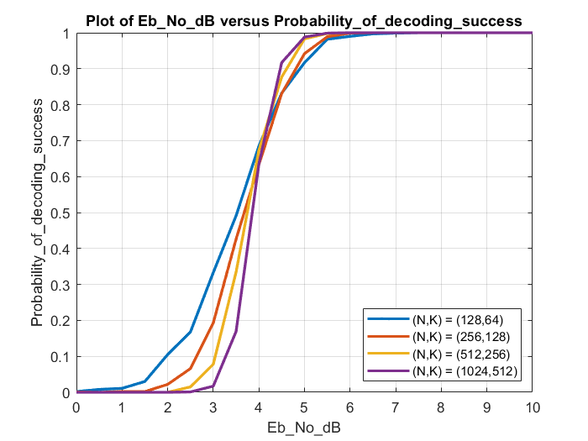
62

Slide 63
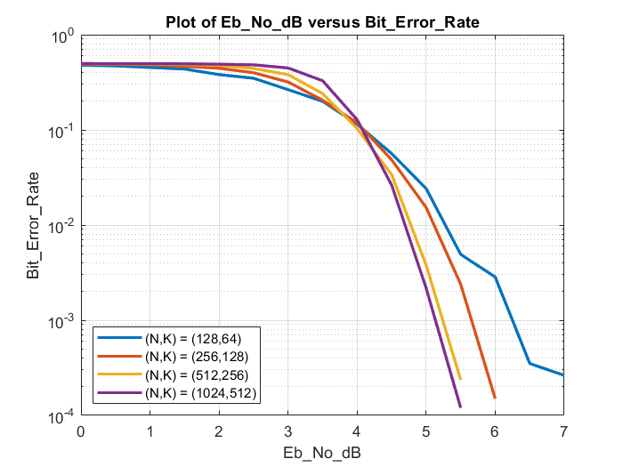
63

Slide 64
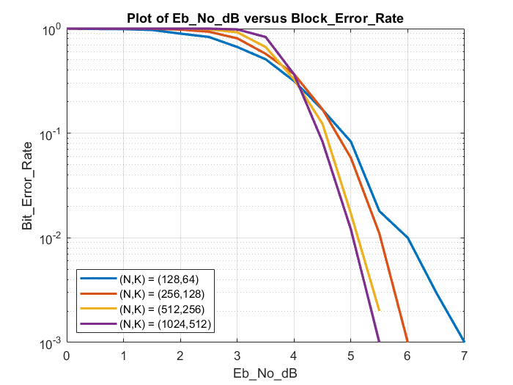
Block_Error_Rate
64

Slide 65
Decoder Comparison Outputs

Slide 66
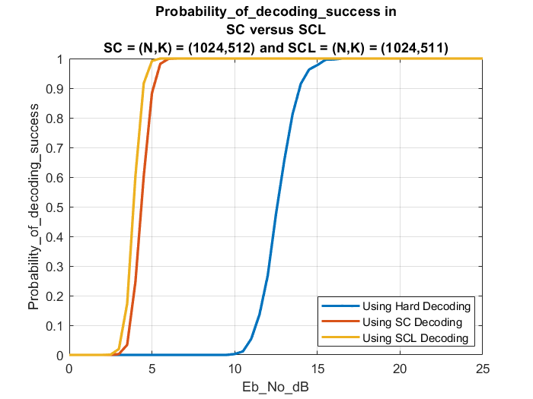
65

Slide 67
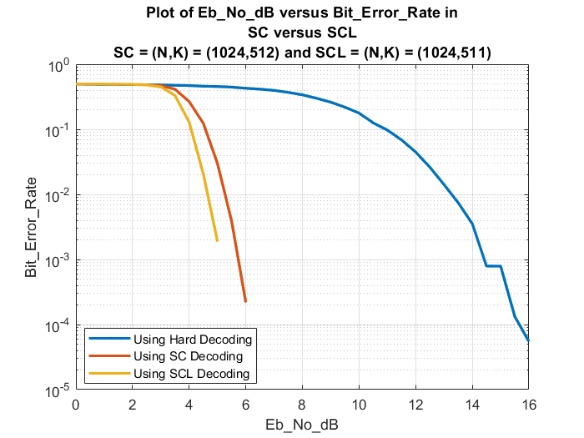
67

Slide 68
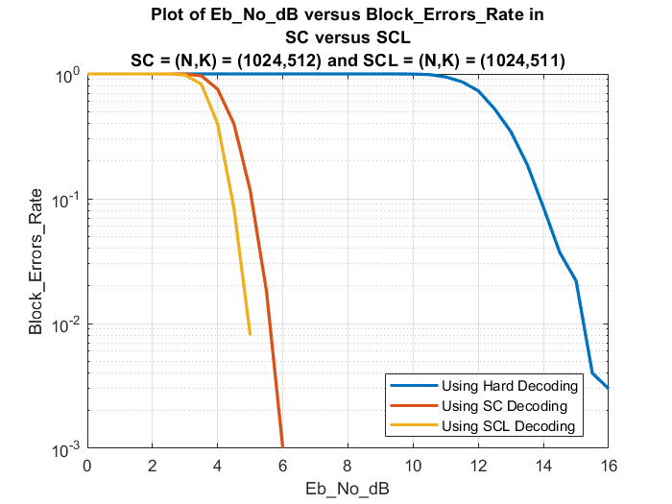
68

Slide 69
Comparing
Functionality Test

Slide 70
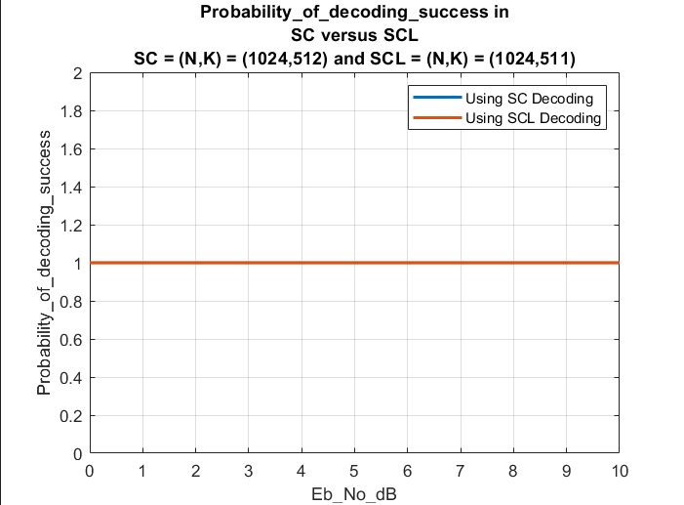
70

Slide 71
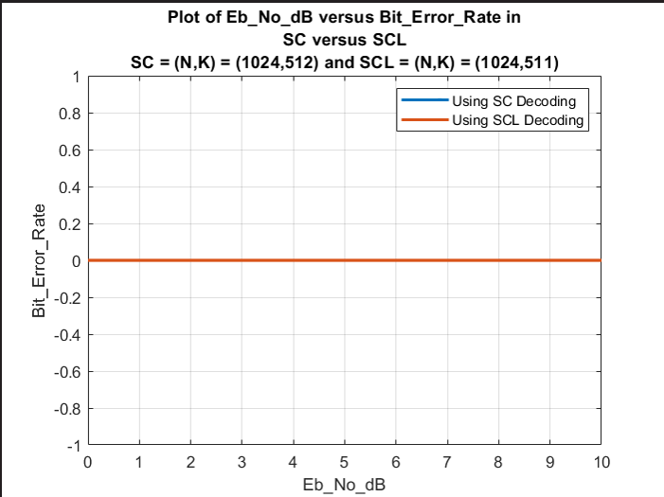
71

Slide 72
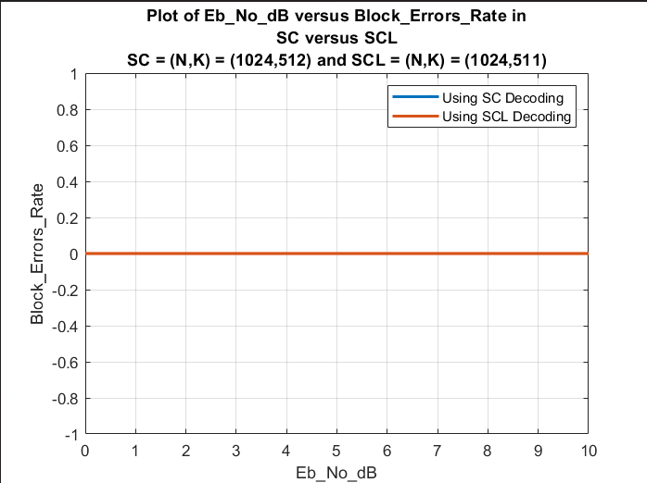
72

Slide 73
Analyzing the Differences Between
Polar Codes and LDPC Codes

Slide 74
Factors:
1. Shannon capacity:
LDPC: Operates near the Shannon limit for high reliability.
Polar: Can match Shannon capacity in ideal scenarios.
2. BER:
Polar: Low BER for short messages.
LDPC: Superior BER for long messages.
3. Throughput:
LDPC: High throughput, ideal for large data volumes.
Polar: Potential throughput limitations for extensive data streams.
4. Latency:
Polar: Lower latency, suitable for real-time applications.
LDPC: Slightly higher latency, especially for time-sensitive tasks.
74

Slide 75
Appendix

Slide 76
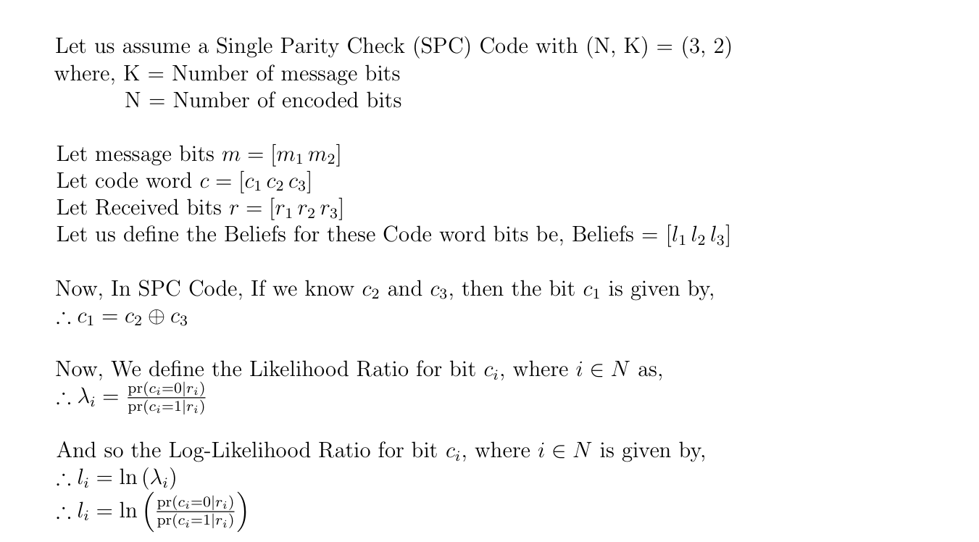
SISO Decoder for SPC
76

Slide 77
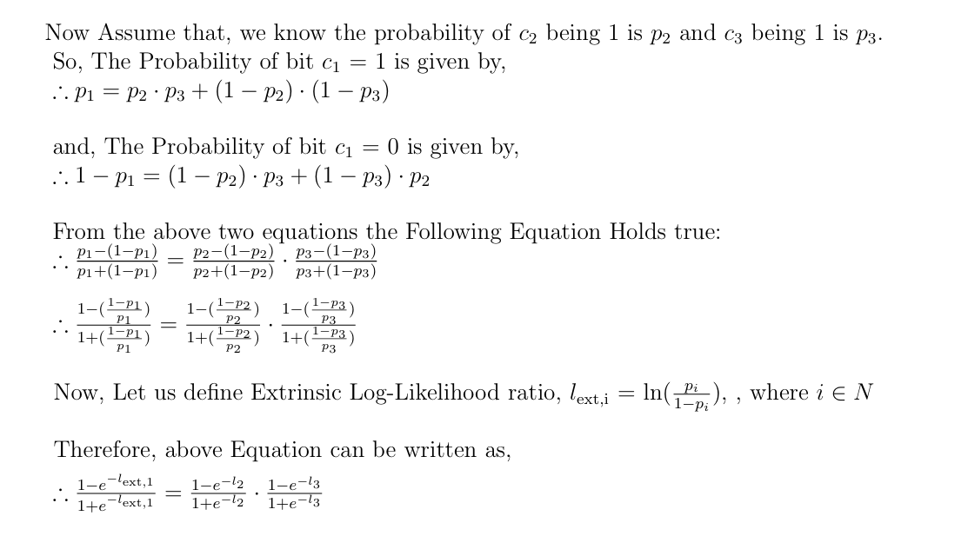
77

Slide 78
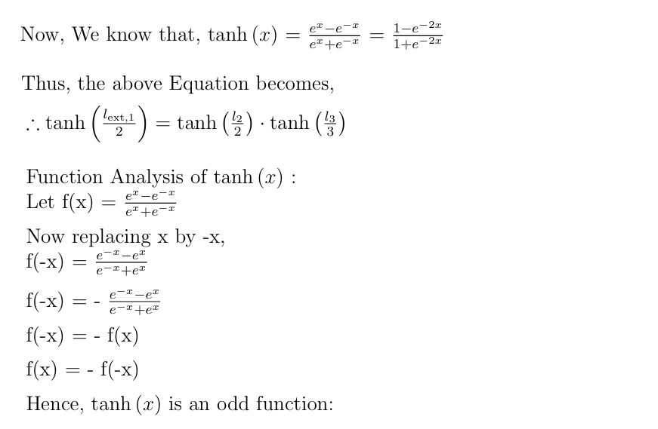
78

Slide 79
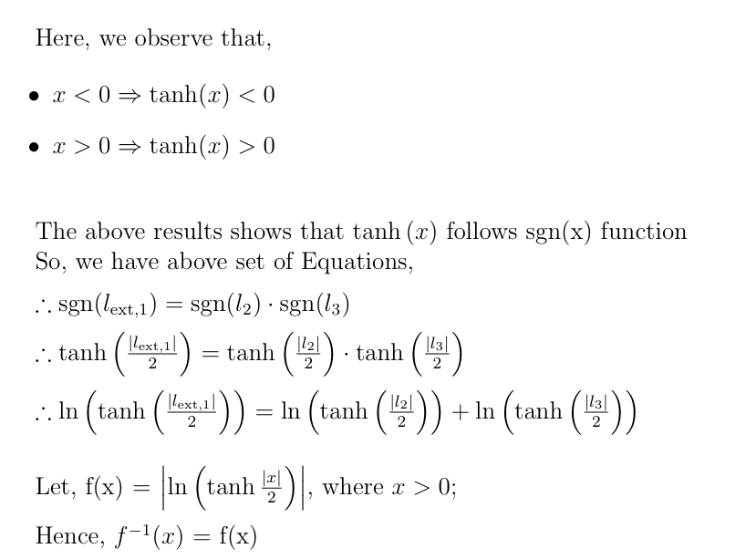
79

Slide 80

80

Slide 81

SISO Decoder for Repetition Code
81

Slide 82

82

Slide 83

83

Slide 84
References
Polar Codes in 5G Standard by Prof. Andrew Thangaraj
Essence of Polar Codes by Dr. Erdal Arikan
Flesh of Polar Codes by Dr. Emre Telatar
Summary on Polar codes by Prof. Tufail Ahmad
Slides by Dr. Erdal Arikan
Channel Polarization: A Method for Constructing Capacity-Achieving Codes for Symmetric Binary-Input Memoryless Channels
On the rate of Channel Polarisation
Source Polarisation by Dr. Erdal Arikan
A Brief Introduction to Polar Codes by Dr. Henry Pfister
Simplified Calculation of Bhattacharyya Parameters in Polar Codes
Polar codes: Primary concepts and practical decoding algorithms
84

Slide 85
Thank You!

